Slide 1


How to identify which user is running which query?
How to delete the profiler collection ?

Slide 2
MongoDB Tools

Slide 3
Utilities
The MongoDB distribution includes a number of utilities that quickly return statistics about instances’ performance and activity.
Typically, these are most useful for diagnosing issues and assessing normal operation.
  mongostat
  mongotop

Slide 4
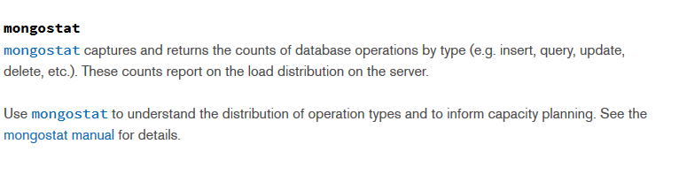
mongostat

Slide 5
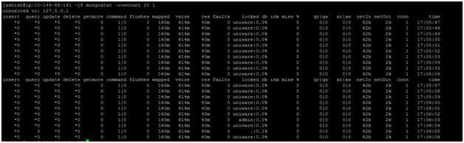
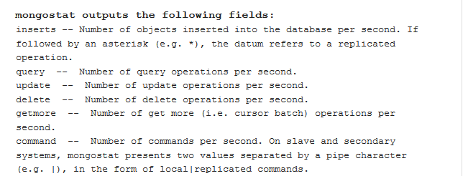
mongostat

Slide 6
mongotop
mongotop provides a method to track the amount of time a MongoDB instance spends reading and writing data.
mongotop provides statistics on a per-collection level.

Slide 7
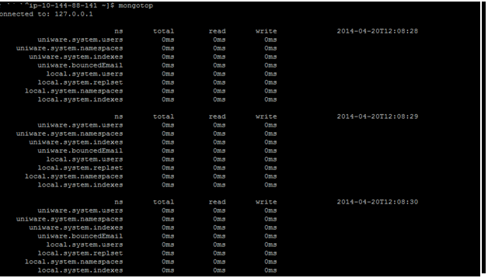
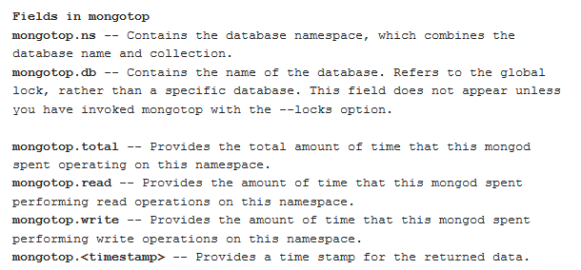
mongotop

Slide 8
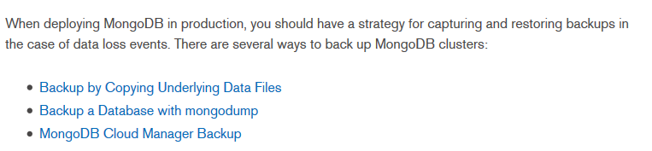
MongoDB Backup Methods

Slide 9
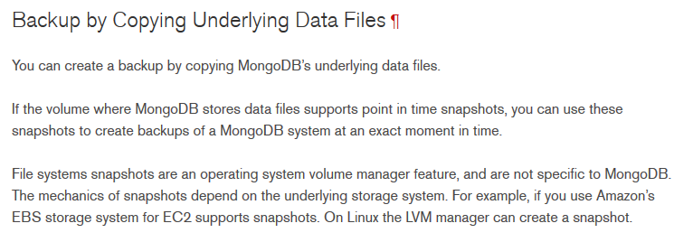
Backup by Copying Underlying Data Files

Slide 10
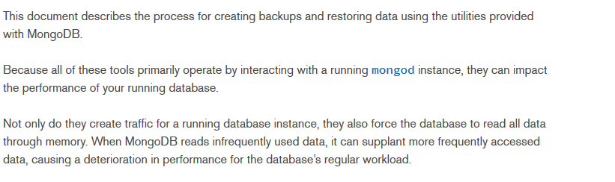
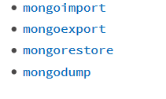
Back Up and Restore with MongoDB Tools

Slide 11
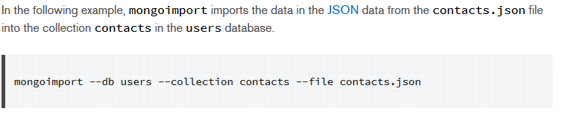
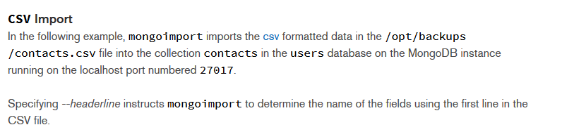

mongoimport

Slide 12
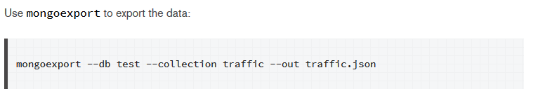
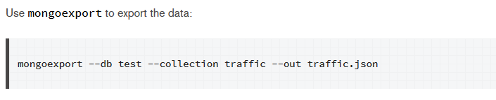

mongoexport

Slide 13
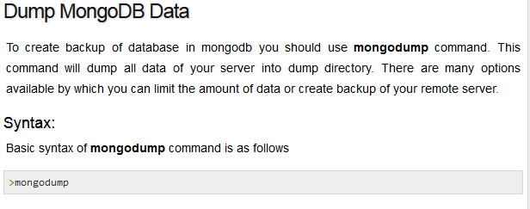
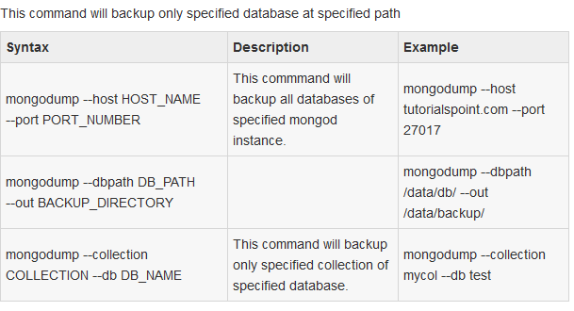
mongodump

Slide 14
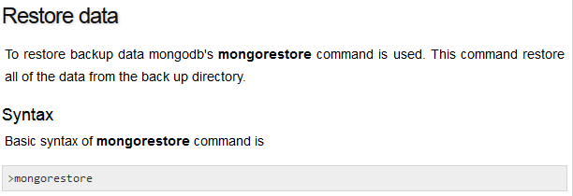


mongorestore

Slide 15

what is mongolab?
What are opensource tools for mongodb?

